Slide 1
The Perfect Bottle: Quality through Chemistry
By: Megan Dang, Arvind Kamboh, Matthew Barclay, and Riley Baumgarten

Slide 2
Motivation for the Project
Motivation for the Project
When you go to supermarkets/liquor stores you search for the perfect bottle of wine whether that be a specific type like Red or White, Pinot Noir or Cabernet Sauvignon, a certain price point, or even choosing based on the label picture.
A lot of the time a buyer can only assume. Certain wineries are known for having good blends however not every vintage (year) is going taste the same.
Our group wanted to dive into what makes a real quality wine and one of the best ways we found is by examining wine’s chemical composition; in our dataset: the predictors.

Slide 3
About the Data
12
1599
0
Portuguese "Vinho Verde" wine
Numerical Variables
[Cortez et al., 2009]
Total observations
Missing Values

Slide 4
Research Problem:
Can we predict the quality of a wine based on its chemical properties?

Slide 5
Why predict quality?
Price
Demand
Reputation
Highly rated wines can command higher prices
High ratings for a wine spurs sales
Wineries with consistent quality can build brand loyalty

Slide 6
Methodology
Methodology
Linear Regression Model
KNN
Correlation
Stepwise AIC

Slide 7
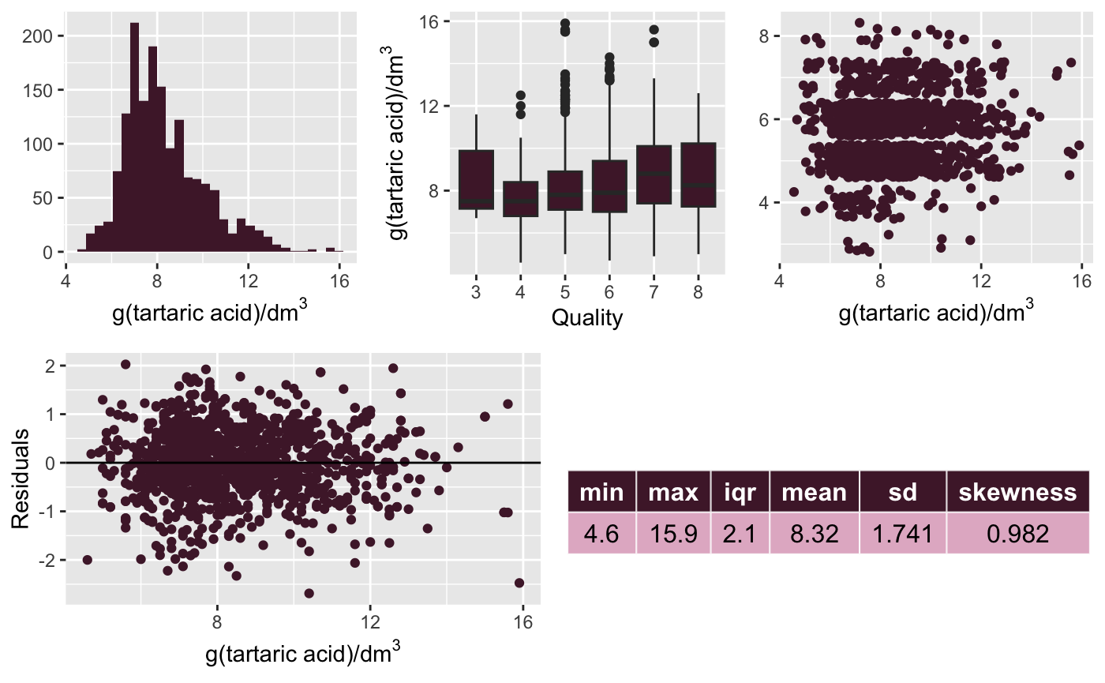
Fixed Acidity
Most common fixed acids in wines are: tartaric, malic, citric, and succinic
Calculated from Total acidity - Volatile acidity

Slide 8
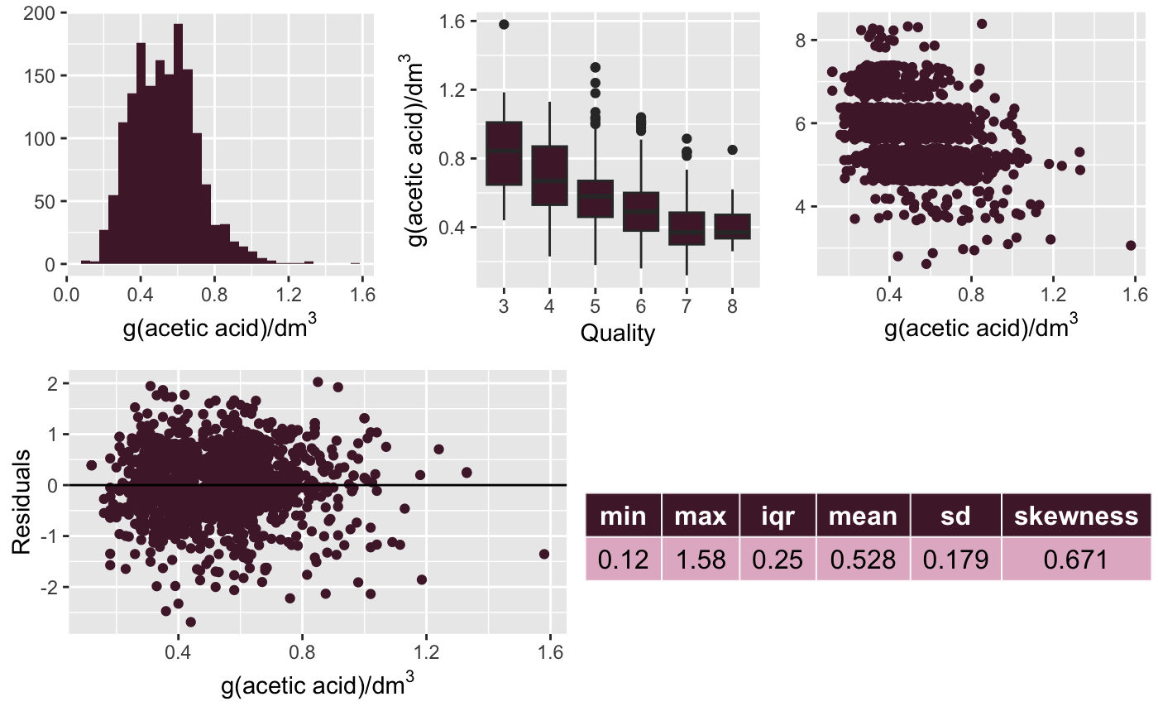
Volatile Acidity
Primary acid in volatile acidity is acetic acid
This gives wine the smell and taste of vinegar

Slide 9
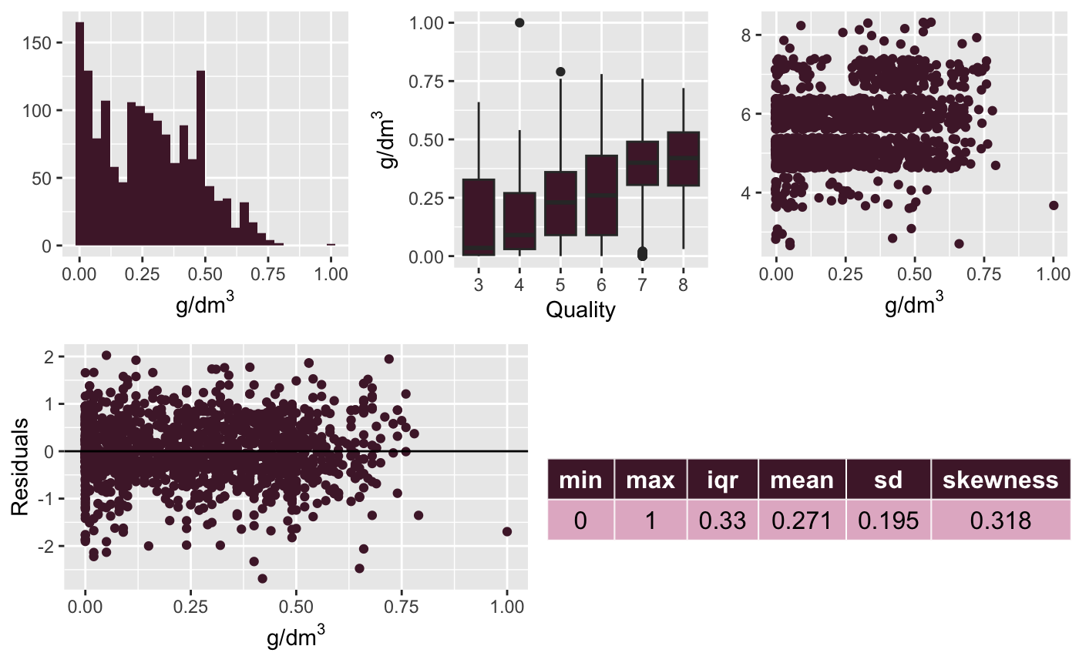
Citric Acid
Relatively low in wine
Can be added to increase acidity or to counteract tannic haze (iron instability which produces tannis)

Slide 10
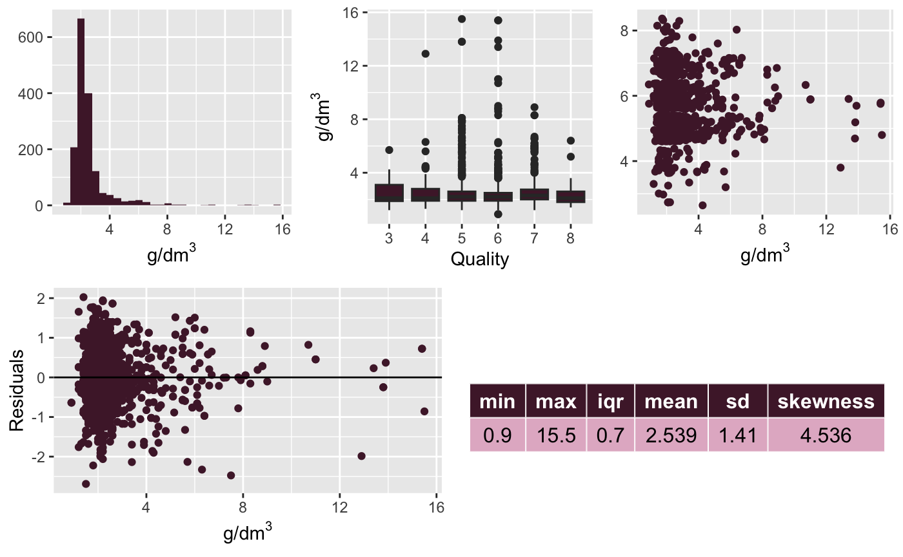
Residual Sugar
Natural grape sugars left over after the alcohol fermentation is completed

Slide 11
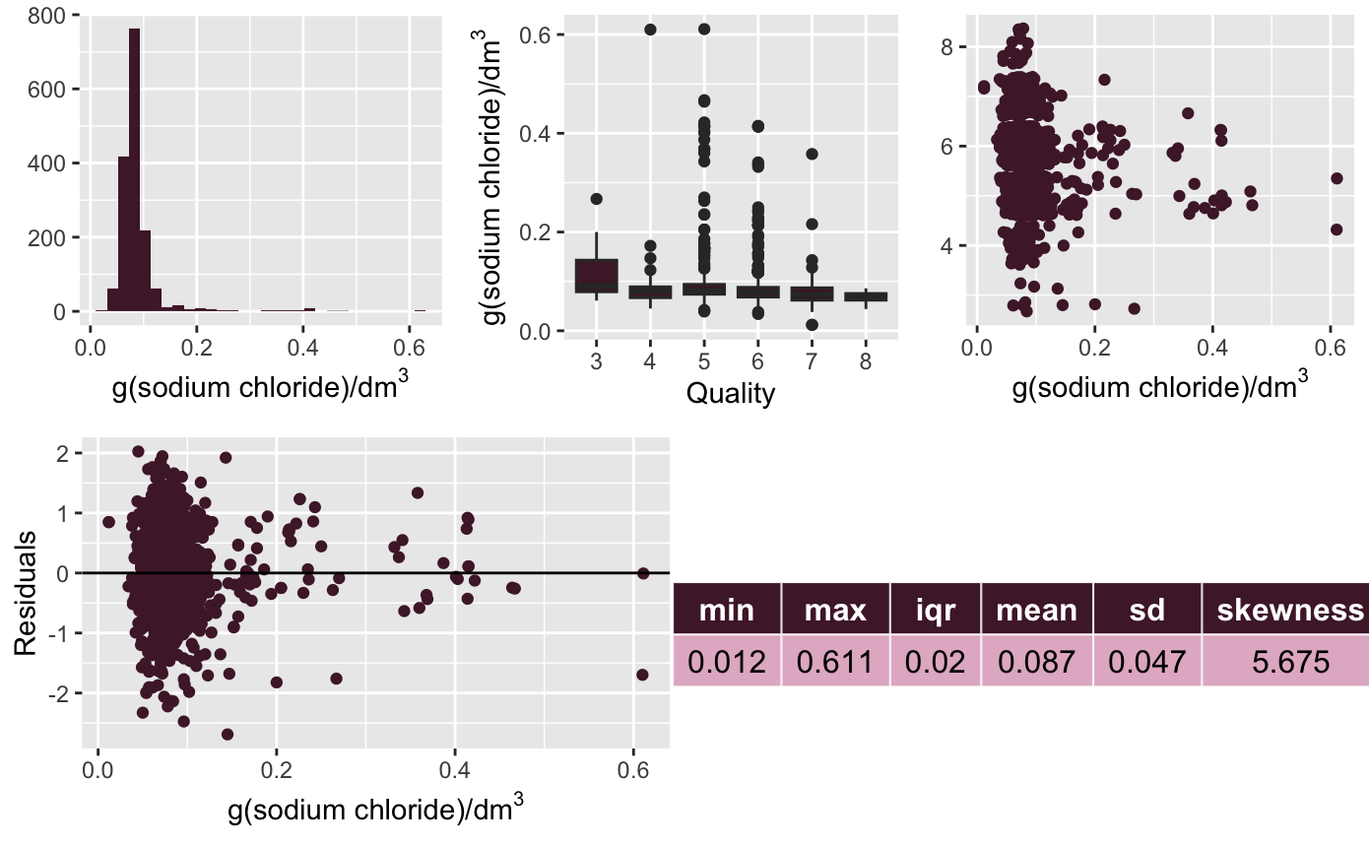
Chlorides
Add to the saltiness of the wine
Adjusting the acidity and taste.

Slide 12
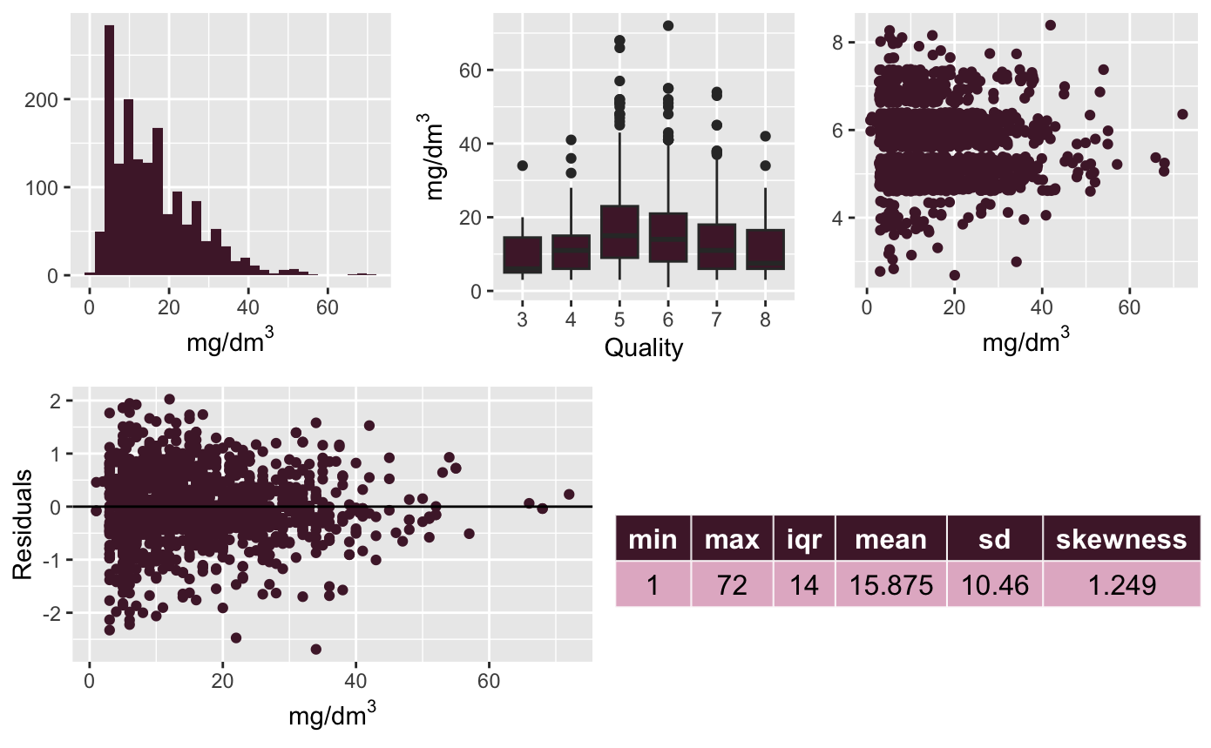
Free Sulfur Dioxide
A natural byproduct of fermentation
Sulfite free means there are no added sulfites in the wine

Slide 13
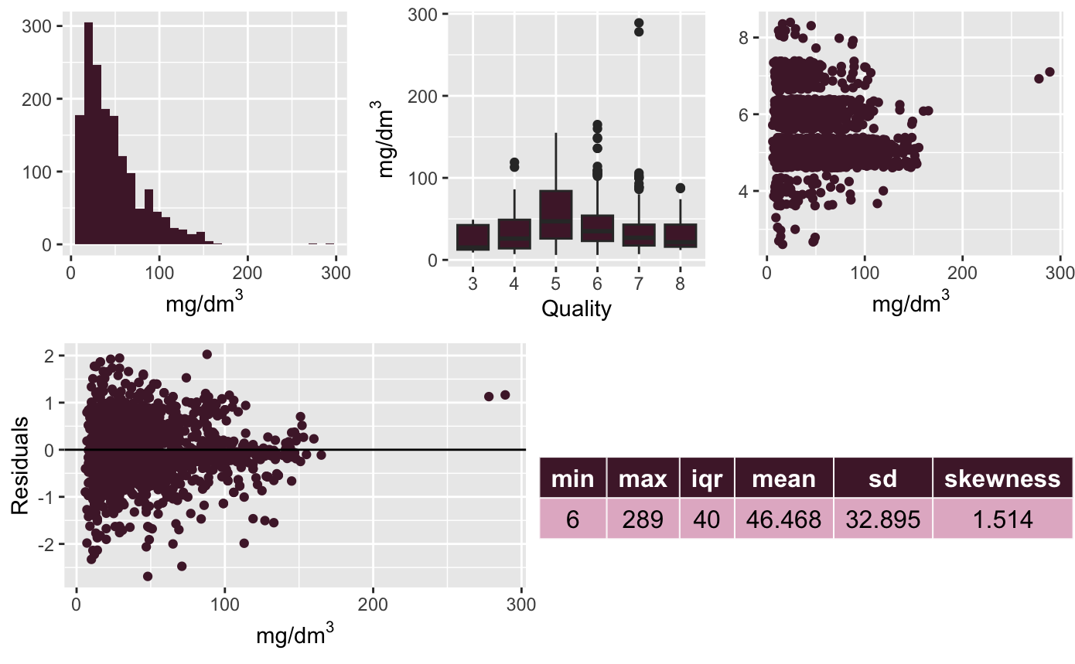
Total Sulfur Dioxide
Preservative and enhancer
Used to stop fermentation or help protect the wine

Slide 14
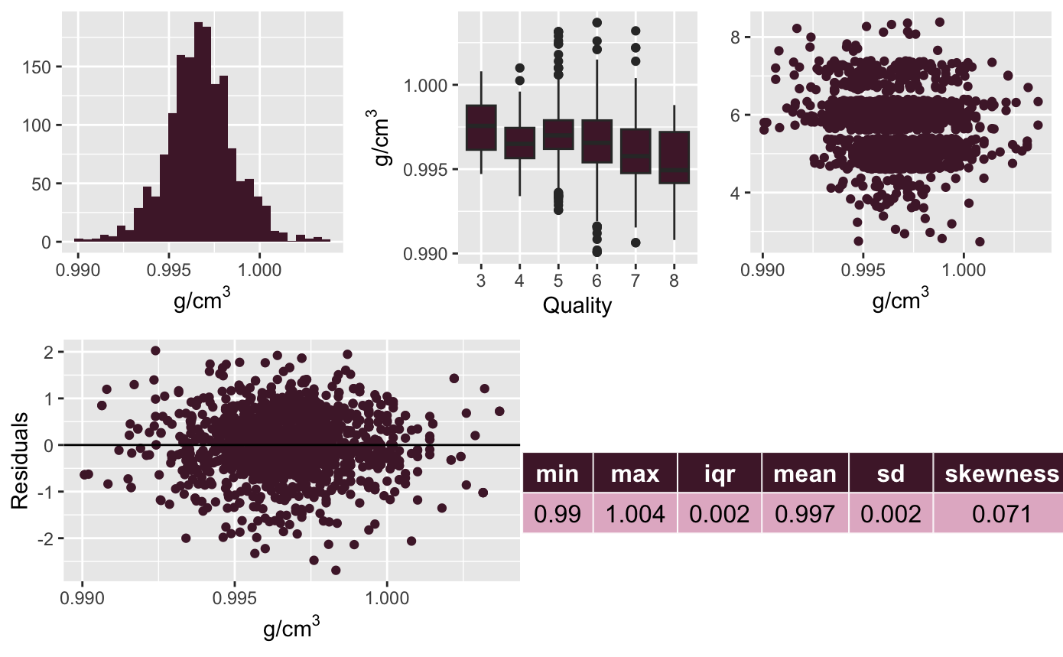
Density
Has little effect on wines
Allows for overall control of juice volume in the fermentation process.

Slide 15
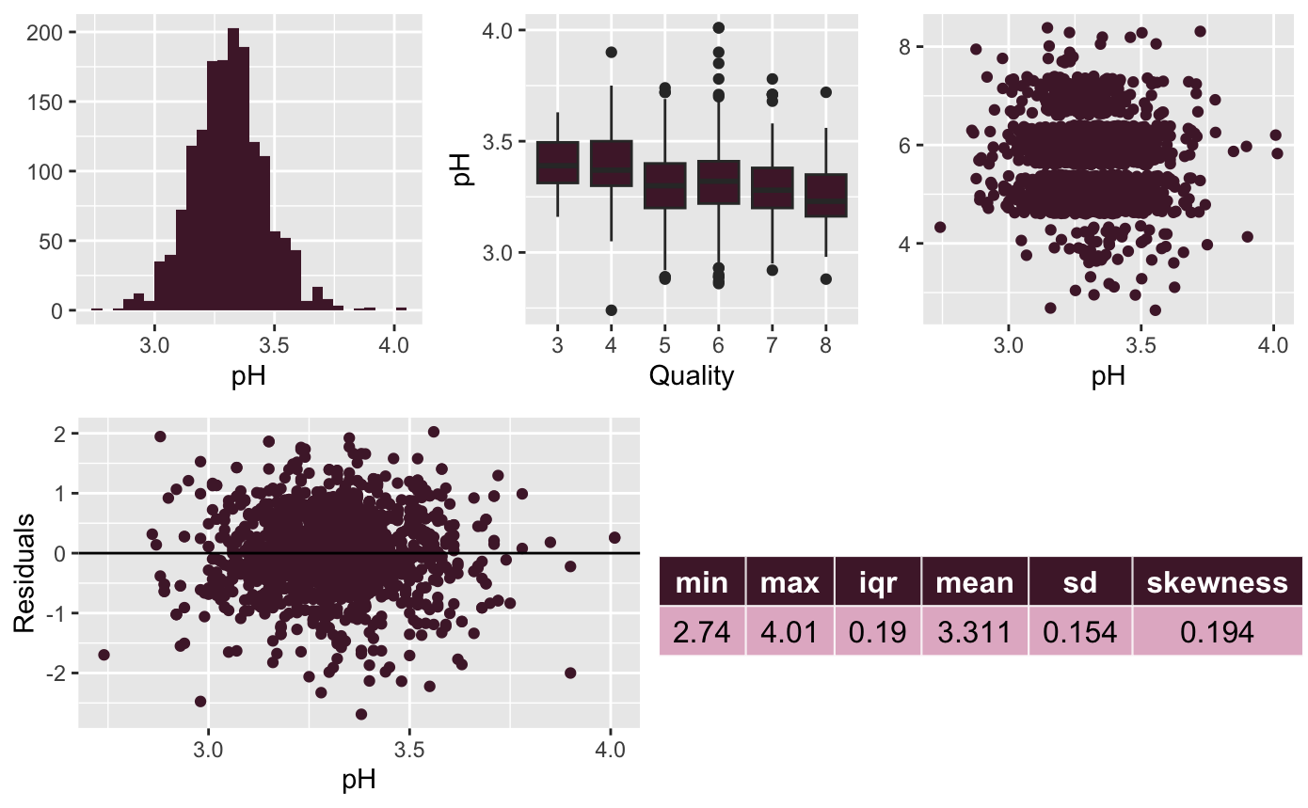
pH
Acidity level
Ranging on a log scale from 0 (very acidic) to 14 (very basic) with 7 being neutral

Slide 16
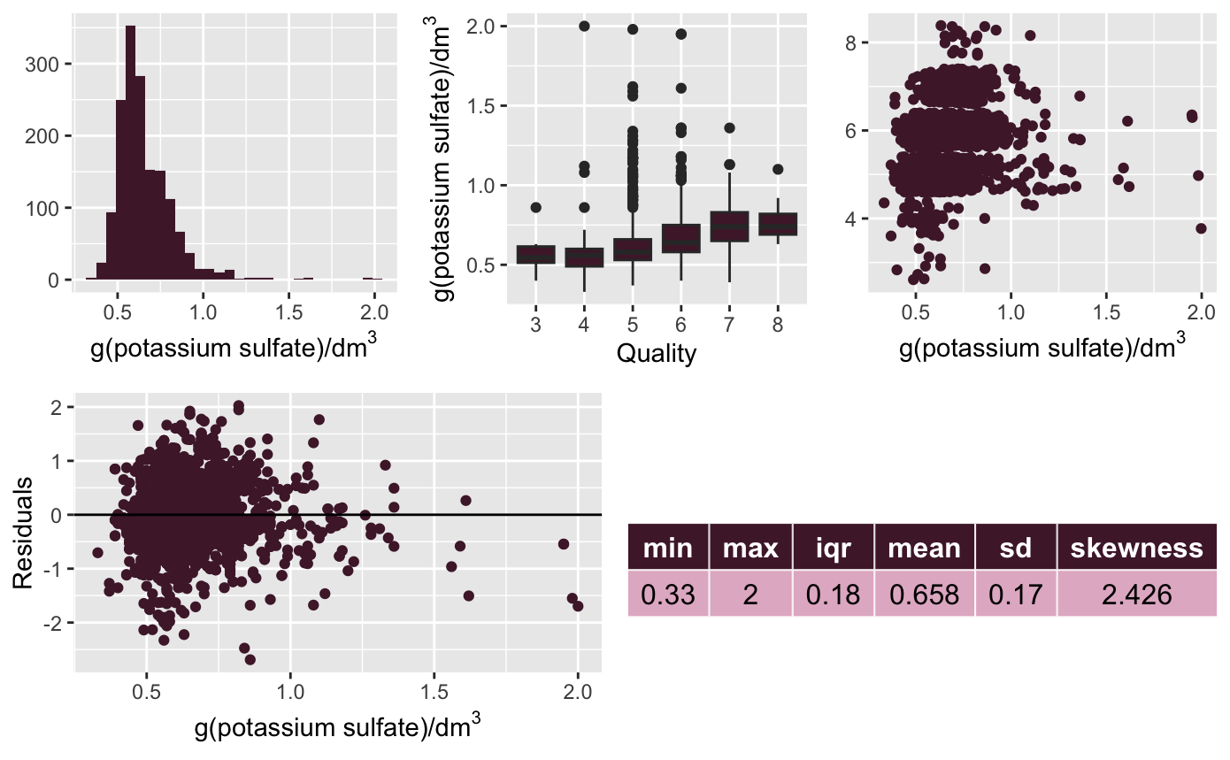
Sulphates
Antioxidant that fights off microbial entities that would spoil the wine.
Little is needed, approx. 1/2 teaspoon/gal of wine.
Notes:
In the histogram, we can see a relatively normal distribution
with a slight positive skew. The boxplot shows several outliers throughout the entire distribution, with
a majority of them existing around the center. The scatter plot is mostly clustered with a slight positive
correlation including the few outliers. The residual plot shows plots that are closely packed in the
left side of the graph and has a few outliers that exist as the potassium sulfate increases. There is a skewness of 2.426, mean of 0.658, sd of 0.17, and IQR of 0.18

Slide 17
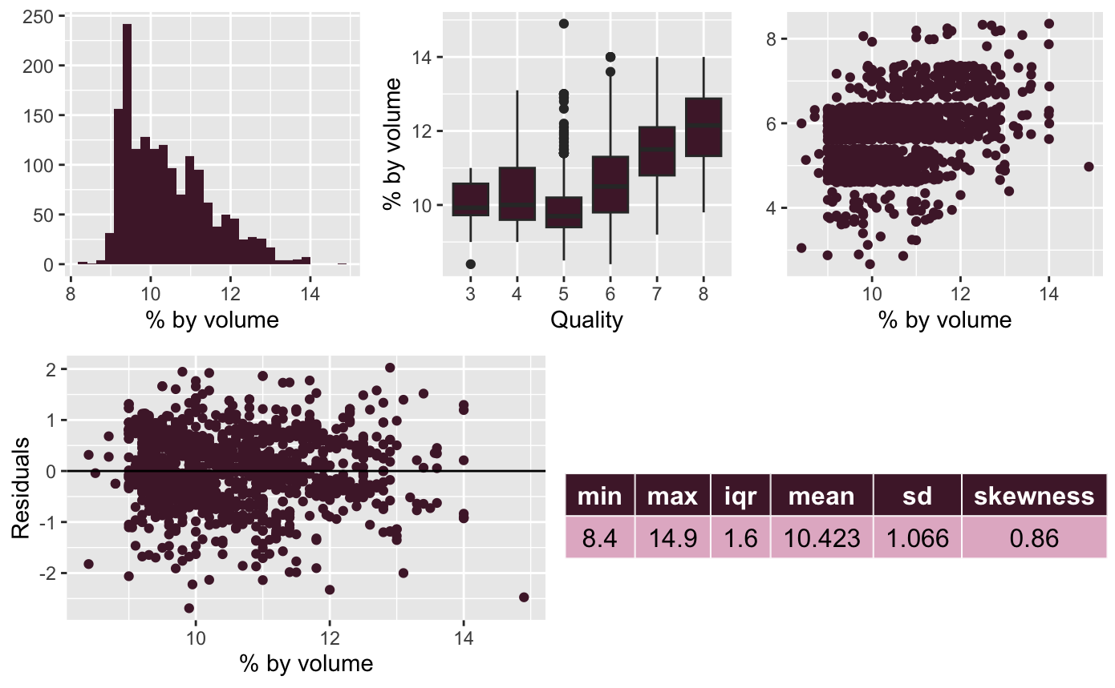
Alcohol
The amount of ethanol in a given volume
Amount usually ranges from 5% to 25% in wine
Higher alcohol usually translates to a more “full-bodied” wine.
Notes:
In the histogram, we can see a relatively positive skew in the distribution.
The Boxplot shows several outliers in the middle of the distribution.
The scatter plot is mostly clustered with a slight positive correlation.
The residual plot shows plots that are closely packed in the center and widely scattered around the edges with a few outliers.
There is a skewness of 0.86, mean of 10.423, sd of 1.066, and IQR of 1.6.

Slide 18
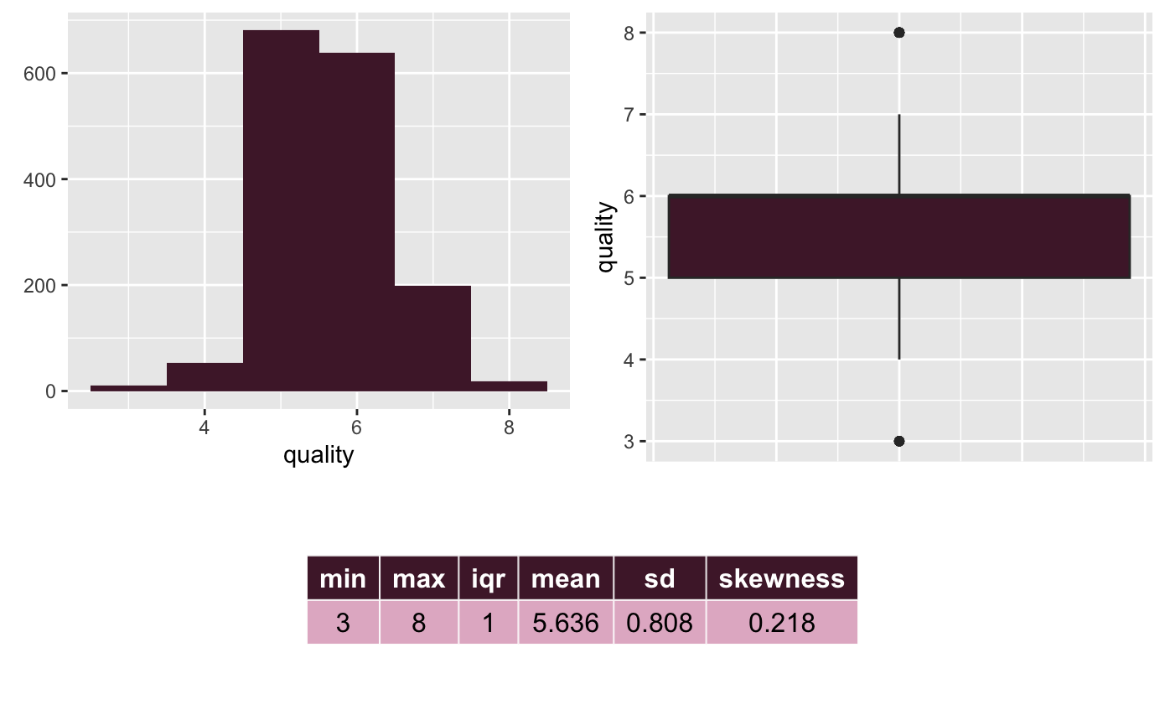
Dependent: Quality
Overall Quality sits around 5-6 out of 10 on average
Very small amounts of wines around 8 (max)
Suggests that overall this type of wine : Vinho Verde, tends to be just an “average wine”

Slide 19
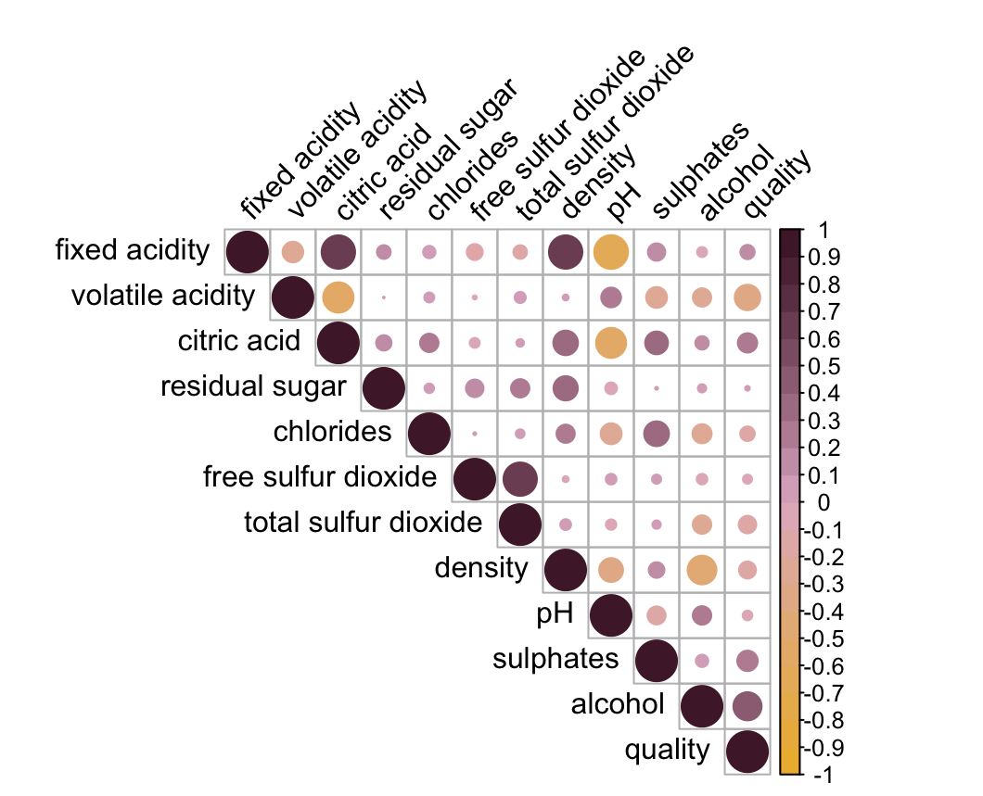
Correlation
Quality is most correlated with alcohol content and volatile acidity
Expect that these will be important in the linear regression model
Negative correlation between the predictors volatile acidity, citric acid, fixed acidity, and pH
Higher amounts of acid will result in a lower pH

Slide 20
Linear Regression
Used backwards stepwise AIC variable selection
Optimal linear regression model equation:
Quality = βi + β1VolatileAcidity + β2Chlorides + β3FreeSulfurDioxide + β4TotalSulfurDioxide + β5pH + β6Sulfates + β7Alcohol
Removed the following predictors as insignificant:
• Fixed Acidity
• Citric Acid
• Residual Sugar
• Density
The full model AIC was -1375.49
Minimized to -1380.79 through the stepwise AIC process

Slide 21
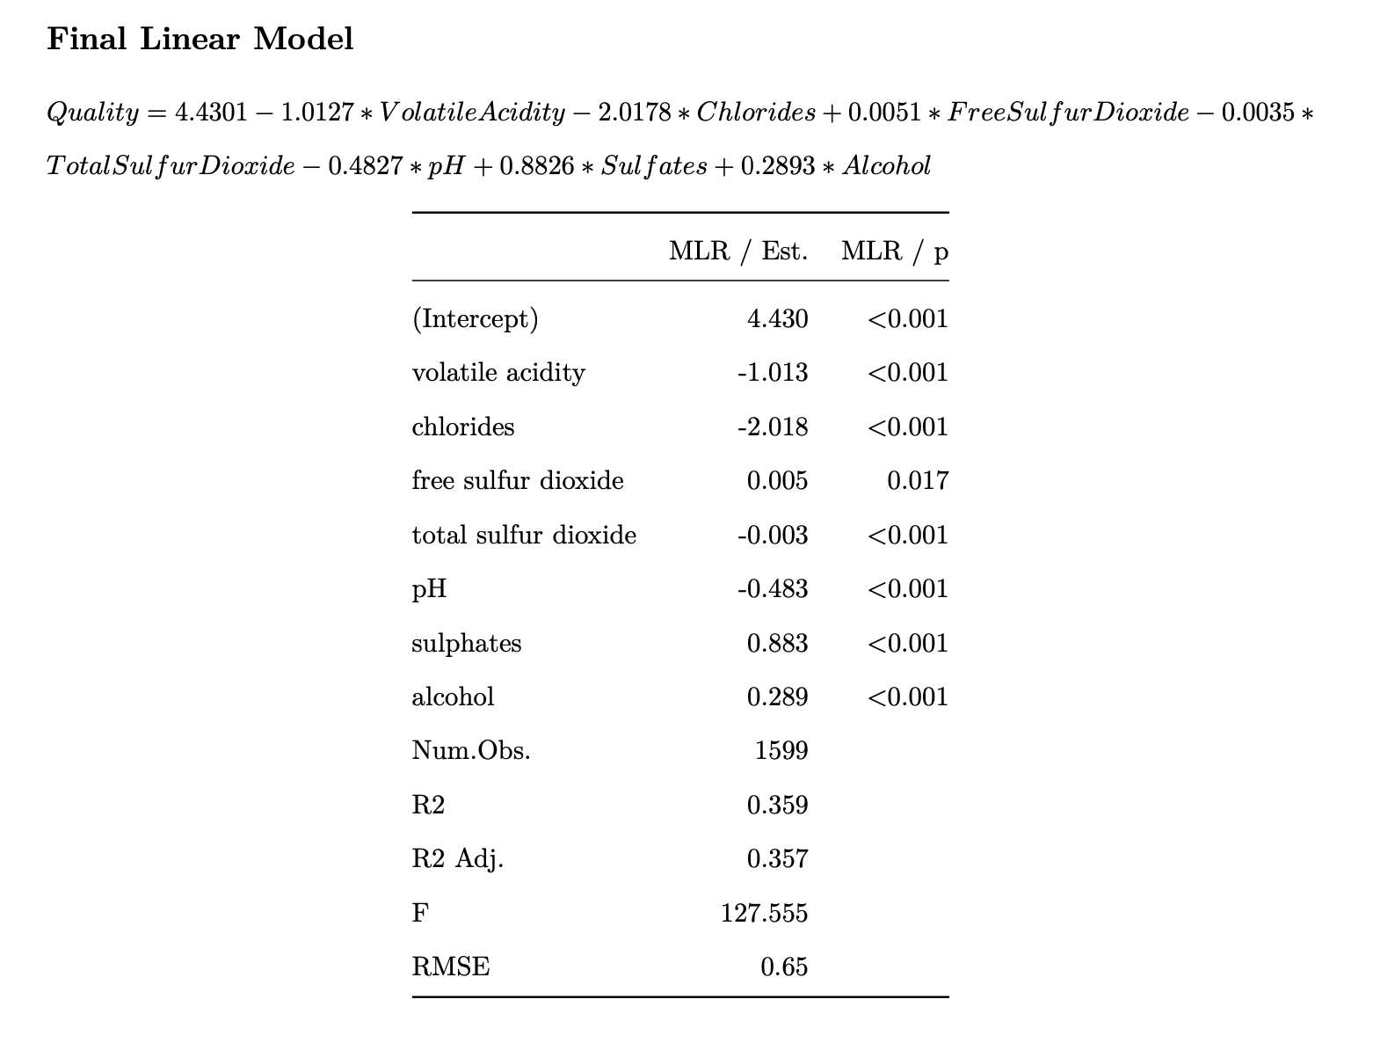
Linear Model

Slide 22
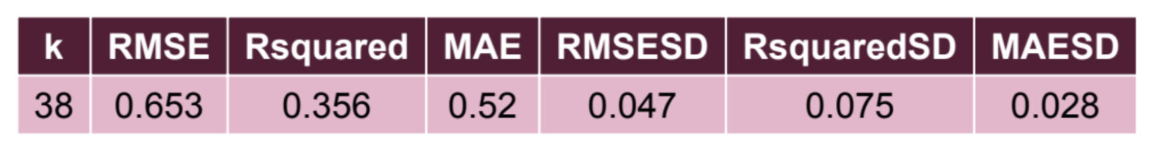
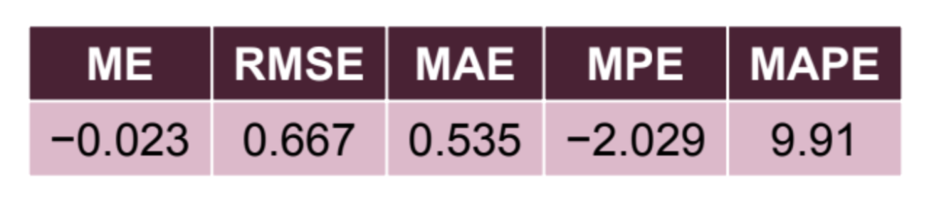
KNN
KNN Model
Optimal parameter value for k was determined to be 38
KNN Validation
Test partition of 40% of the dataset
Predicted RMSE and MAE values being close to the training data model
Not significant overfitting

Slide 23
Conclusion
Linear regression slightly better at prediction
Fewer predictors
Slightly lower RMSE and MAPE
Slightly higher R²
Both models were pretty good given subjective nature of quality
R² ~0.36 for both models
Both models useful for wine industry

Slide 24

Further Exploration
Comparing the Vinho Verde wine to other types would foster new and valuable insights to evaluate winemaking processes
Finding out which predictor variables (specifically their numerical amounts) are associated with health benefits such as antioxidants that support heart health, cholesterol, etc.

